Slide 1
RNA-seq with Galaxy: Basic concepts & hands-on
Sijung Yun, Ph.D.
November 12, 2024

Slide 2
Central Dogma of molecular biology
DNA
RNA
Protein
Biological Function
Transcription
Translation
Image from: https://www.news-medical.net/life-sciences/-Types-of-RNA-mRNA-rRNA-and-tRNA.aspx

Slide 3
Why do we care RNA?
Gene expression
…
DNA
mRNA
Protein
Biological Function
Transcription

Slide 4
If you can quantify all the rna’s (rna-seq) in your samples, then, you can answeR …

Slide 5
Differential gene expression – most popular –
Finding RNAs quantitatively in genome-wide scale
Then, compare control vs. experiment to find out
Differential Gene expression ➔ Most popular application of RNA-seq

Slide 6
RNA-seq procedure
Experiment
Bioinformatics
Align the raw reads to a genome with a RNA-seq aligner
Isolate RNA
Convert to cDNA using reverse transcriptase
Make a library and sequence it
Preprocess the reads for quality control
Quantify with normalization
Construct Transcriptome
Library preparation
Perform statistical tests for differential expression
Pathway & Network analysis
Misc.: (Mathematical modelling, gene ontology, combined analysis with other seq’s, …
Further analysis (Optional)
Clustering: Principal Component Analysis (PCA), Hierarchical clustering, etc.
Visualization: Heatmap, Volcano plot, Scatter plot, etc.

Slide 7
RNA-seq procedure
Experiment
Bioinformatics
Align the raw reads to a genome with a RNA-seq aligner
Isolate RNA
Convert to cDNA using reverse transcriptase
Make a library and sequence it
Preprocess the reads for quality control
Quantify with normalization
Construct Transcriptome
Library preparation
Perform statistical tests for differential expression
Pathway & Network analysis
Misc.: (Mathematical modelling, gene ontology, combined analysis with other seq’s, …
Further analysis (Optional)
Clustering: Principal Component Analysis (PCA), Hierarchical clustering, etc.
Visualization: Heatmap, Volcano plot, Scatter plot, etc.

Slide 8
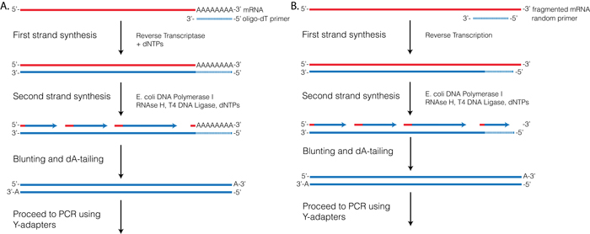
cDNA synthesis
Oligo dT priming
Random hexamer priming
Images from http://rnaseq.uoregon.edu/

Slide 9
RNA-seq procedure
Step 1
Step 2
Step 3
Step 4
Step 5
Step 6
Isolate RNA
Convert to cDNA using reverse transcriptase
Make a library and sequence it
(Bioinformatics) Preprocess the reads for quality control
(Bioinformatics) Align the raw reads to a genome with a RNA-seq aligner
(Bioinformatics) Quantify with normalization and perform statistical analysis

Slide 10
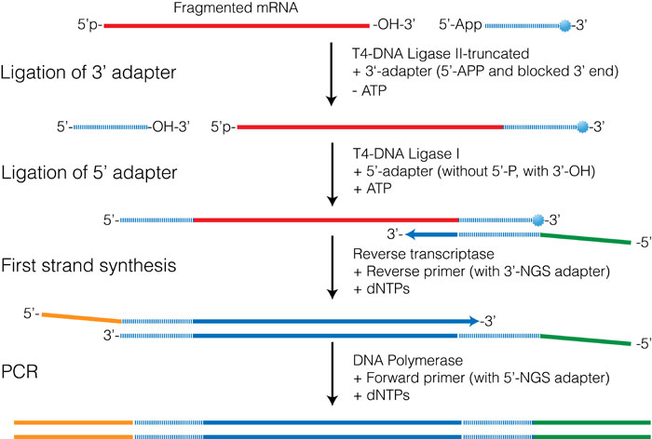
Library preparation (Unstranded)
Images from http://rnaseq.uoregon.edu/

Slide 11
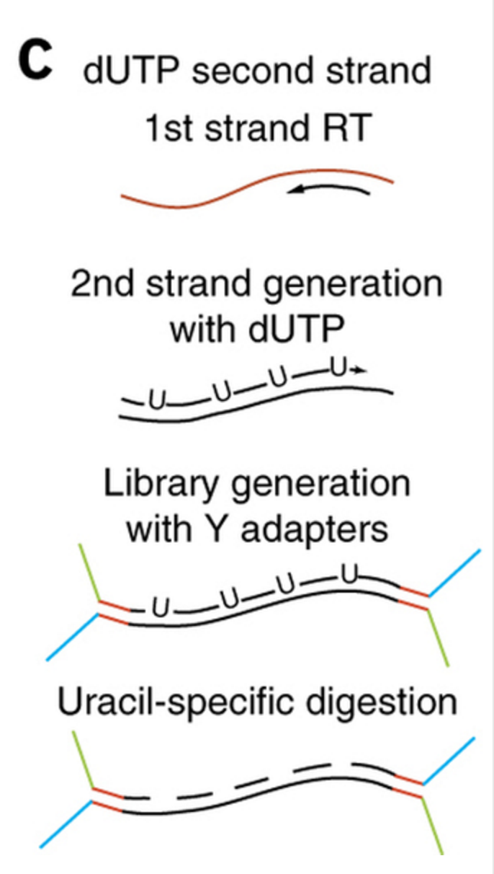
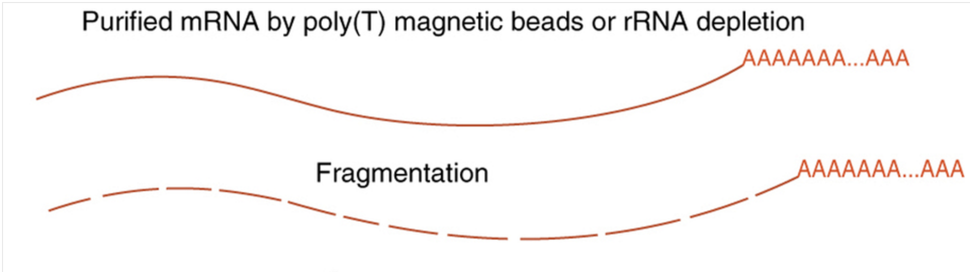
Library preparation (Stranded)
Step 1
Step 2
Shin et al., Nature Neuroscience 17, 1463–1475 (2014)

Slide 12
RNA-seq procedure
Experiment
Bioinformatics
Align the raw reads to a genome with a RNA-seq aligner
Isolate RNA
Convert to cDNA using reverse transcriptase
Make a library and sequence it
Preprocess the reads for quality control
Quantify with normalization
Construct Transcriptome
Library preparation
Perform statistical tests for differential expression
Pathway & Network analysis
Misc.: (Mathematical modelling, gene ontology, combined analysis with other seq’s, …
Further analysis (Optional)
Clustering: Principal Component Analysis (PCA), Hierarchical clustering, etc.
Visualization: Heatmap, Volcano plot, Scatter plot, etc.

Slide 13
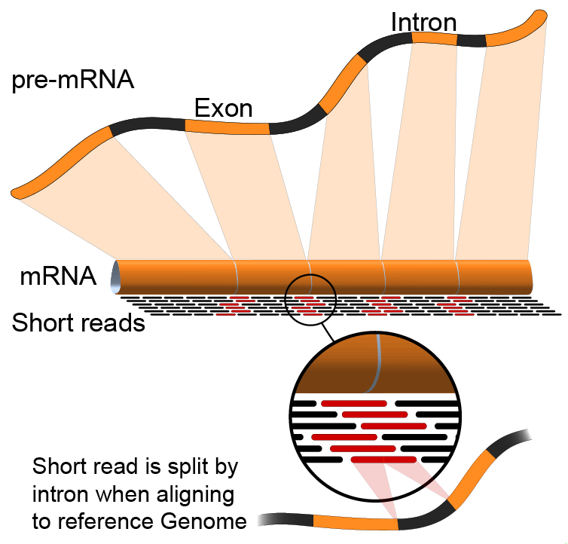
Why do we need an RNA-seq aligner?

Slide 14
Popular RNA-seq aligners
TOPHAT2
http://ccb.jhu.edu/software/tophat/index.shtml
HISAT2
https://github.com/infphilo/hisat2
STAR
https://github.com/alexdobin/STAR
BBMAP
https://sourceforge.net/projects/bbmap/
Others
ERANGE, IsoformEx, MapAL, OSA, PRADA, RNA-MATE, RUM, RNASEQR, SAMMate, SpliceSeq, X-Mate, ABMapper, ContextMap, CRAC, GSNAP, HMMSplicer, MapSplice, PALMapper, Pass, PASSion, PASTA, RAZER, SeqSaw, SoapSplice, SpliceMap, SplitSeek, SuperSplat, Subread, Subjunc, MapNext, Olego, G.Mo.R-Se, etc…..
Ref: https://en.wikipedia.org/wiki/List_of_RNA-Seq_bioinformatics_tools

Slide 15
Popular RNA-seq aligners
TOPHAT2
http://ccb.jhu.edu/software/tophat/index.shtml
HISAT2
https://github.com/infphilo/hisat2
STAR
https://github.com/alexdobin/STAR
BBMAP
https://sourceforge.net/projects/bbmap/
Others
ERANGE, IsoformEx, MapAL, OSA, PRADA, RNA-MATE, RUM, RNASEQR, SAMMate, SpliceSeq, X-Mate, ABMapper, ContextMap, CRAC, GSNAP, HMMSplicer, MapSplice, PALMapper, Pass, PASSion, PASTA, RAZER, SeqSaw, SoapSplice, SpliceMap, SplitSeek, SuperSplat, Subread, Subjunc, MapNext, Olego, G.Mo.R-Se, etc…..
Ref: https://en.wikipedia.org/wiki/List_of_RNA-Seq_bioinformatics_tools

Slide 16
(Hands-on) Align RNA-seq reads
FASTQ file could be downloaded from
Step 1: Go to the web server, usegalaxy.org
Step 2: Upload the unaligned reads to Galaxy
Step 3: Run an RNA-seq aligner (HISAT) with reference genome hg38 in the Galaxy
~ 10 min
https://github.com/sijungyun/rna_seq_tutorial/raw/refs/heads/main/experiment_replicate_1_R1.fastq.gz
https://github.com/sijungyun/rna_seq_tutorial/raw/refs/heads/main/experiment_replicate_1_R2.fastq.gz

Slide 17
(Hands-on) Align RNA-seq reads
FASTQ file could be downloaded from
Step 1: Go to the web server, usegalaxy.org
Step 2: Upload the unaligned reads to Galaxy
Step 3: Run an RNA-seq aligner (HISAT) with reference genome hg38 in the Galaxy
https://github.com/sijungyun/rna_seq_tutorial/raw/refs/heads/main/experiment_replicate_1_R1.fastq.gz
https://github.com/sijungyun/rna_seq_tutorial/raw/refs/heads/main/experiment_replicate_1_R2.fastq.gz

Slide 18
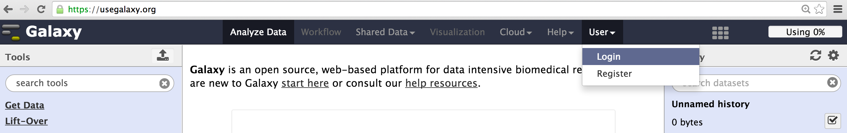
(Hands-on) Align RNA-seq reads
Step 1: Go to the web server, usegalaxy.org
Open a web browser and go to usegalaxy.org
Let’s Login
Click “User” ➔ “Login”

Slide 19
(Hands-on) Align RNA-seq reads
FASTQ file could be downloaded from
Step 1: Go to the web server, usegalaxy.org
Step 2: Upload the unaligned reads to Galaxy
Step 3: Run an RNA-seq aligner (HISAT) with reference genome hg38 in the Galaxy
https://github.com/sijungyun/rna_seq_tutorial/raw/refs/heads/main/experiment_replicate_1_R1.fastq.gz
https://github.com/sijungyun/rna_seq_tutorial/raw/refs/heads/main/experiment_replicate_1_R2.fastq.gz

Slide 20
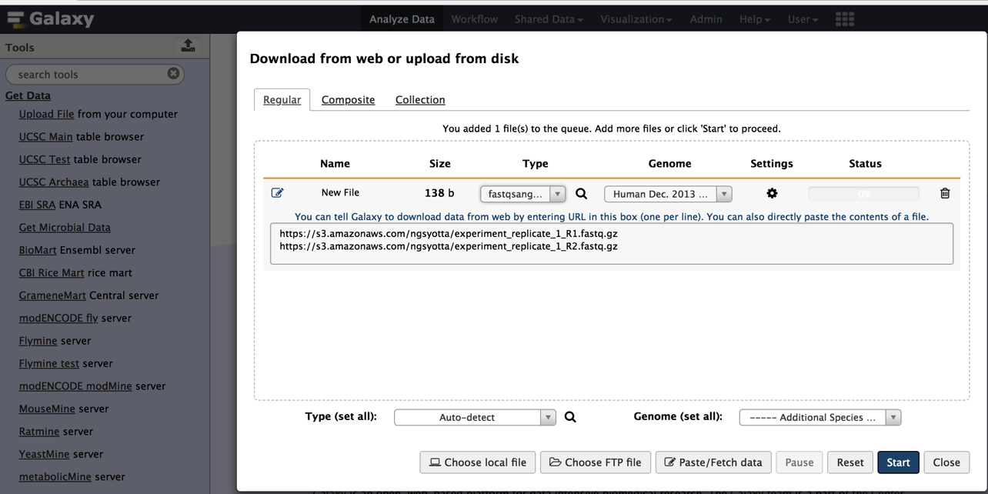
(Hands-on) Align RNA-seq reads
Upload the fastq file to Galaxy
Click “Get Data” in the left column
Click “Upload File from your computer”
Click “Paste/Fetch data”
Type “fastqsanger.gz” in the File Format box
Type the “hg38” to select the genome
In URL/Text box, copy/paste the two following addresses
https://github.com/sijungyun/rna_seq_tutorial/raw/refs/heads/main/experiment_replicate_1_R1.fastq.gz
https://github.com/sijungyun/rna_seq_tutorial/raw/refs/heads/main/experiment_replicate_1_R2.fastq.gz
Click “Start” button
Click “Close” button

Slide 21
(Hands-on) Align RNA-seq reads
FASTQ file could be downloaded from
Step 1: Go to the web server, usegalaxy.org
Step 2: Upload the unaligned reads to Galaxy
Step 3: Run an RNA-seq aligner (HISAT) with reference genome hg38 in the Galaxy
https://github.com/sijungyun/rna_seq_tutorial/raw/refs/heads/main/experiment_replicate_1_R1.fastq.gz
https://github.com/sijungyun/rna_seq_tutorial/raw/refs/heads/main/experiment_replicate_1_R2.fastq.gz

Slide 22
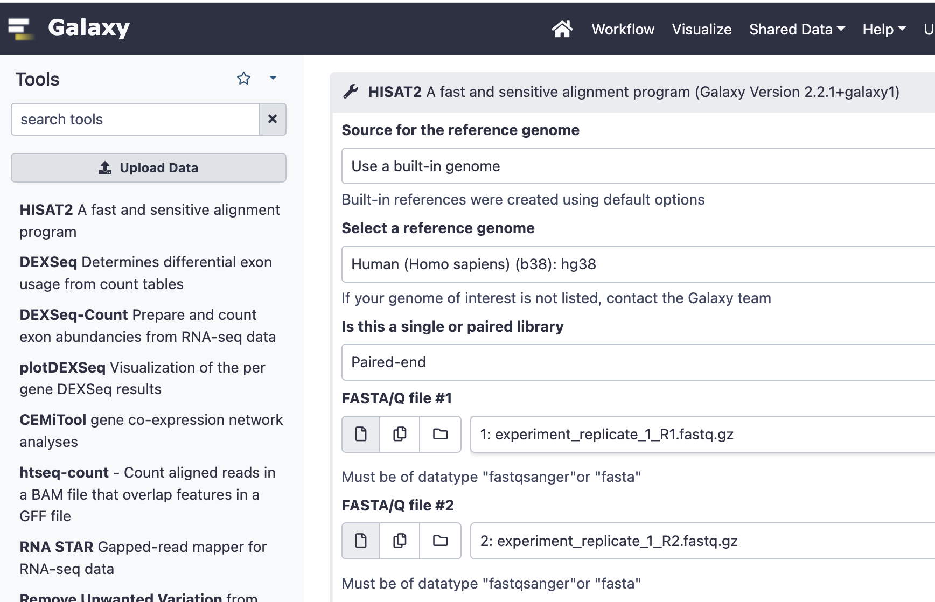
(Hands-on) Align RNA-seq reads
Align the uploaded reads using HISAT
Click RNA-seq
Click HISAT2
Select a reference genome to “hg38”
Choose the “paired-end” for ”Is this a single or paired library
#1 ➔ R1.fastq.gz
#2 ➔ R2.fastq.gz
Click “Execute”

Slide 23
How does the alignment work for spliced reads (in Tophat)?
If a read could not be aligned ➔
(Step 1) Break a read into 25 base long pieces
(Step 2) Align these pieces.
(Step 3) Accept aligned pieces if these are apart within predefined minimum and maximum intron length
(Step 4) The unbroken whole read is aligned to that genomic region to find splice signals (GT-AG, GC-AG or AT-AC)

Slide 24
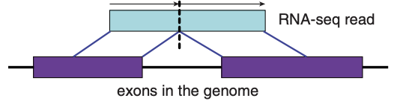
How does the alignment work for spliced reads (in STAR)?
Key points of STAR’s alignment algorithm
Each read is split into multiple seeds that align to a reference genome that requires the perfect match
Seeds are extended for imperfect matches such as SNPs or Indels with penalty in mapping score
STAR achieves its efficient alignment by
Looking for seeds only from unmapped portion of the read
Use uncompressed Suffix Array method
Image from Figure 1
https://www.ncbi.nlm.nih.gov/pmc/articles/PMC3530905/pdf/bts635.pdf
Notes:
The aligner STAR is a splicing known aligner. If a read is not aligned as is, it suspects the read could be a spliced junction read. Each read is split into multiple seeds. Then, each seed is mapped to the reference genome requiring the perfect match. Then, the mapped seed is extended along the reference genome with the read sequence, and insertion and deletions are allowed in this stage, but, indels would lower the mapping quality score due to the penalty score with indel. From the candidate alignments, START choose the best one.

Slide 25
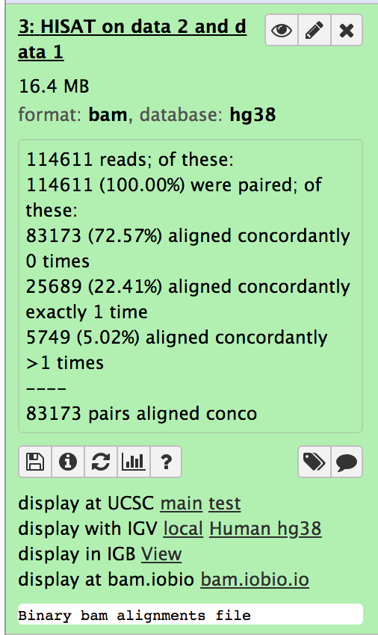
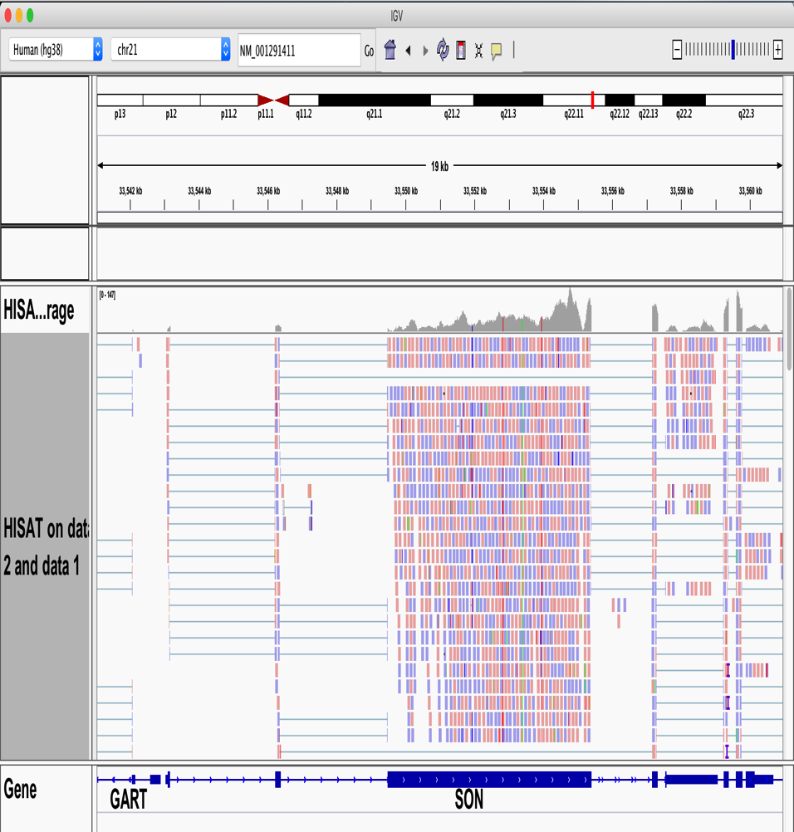
(Optional Hands-on) Visualize the alignment This step works only if your computer (JAVA) is properly configured!
Step1: Open IGV
Step2: Check a transcript
Type “NM_001291411”
Click
Display with IGV
C. elegans (ce)

Slide 26

(Optional Hands-on) Visualize the alignment
Height in this histogram corresponds to the number of reads piled up
Splicing (intron)

Slide 27
(Hands-on) Align three other samples
You aligned one replicate sample under experimental condition ➔ You got one bam file
Align to get three more bam files
Experiment_rep2
Control_rep1
Control_rep2
https://github.com/sijungyun/rna_seq_tutorial/raw/refs/heads/main/experiment_replicate_2_R1.fastq.gz
https://github.com/sijungyun/rna_seq_tutorial/raw/refs/heads/main/experiment_replicate_2_R2.fastq.gz
https://github.com/sijungyun/rna_seq_tutorial/raw/refs/heads/main/control_replicate_1_R1.fastq.gz
https://github.com/sijungyun/rna_seq_tutorial/raw/refs/heads/main/control_replicate_1_R2.fastq.gz
https://github.com/sijungyun/rna_seq_tutorial/raw/refs/heads/main/control_replicate_2_R1.fastq.gz
https://github.com/sijungyun/rna_seq_tutorial/raw/refs/heads/main/control_replicate_2_R2.fastq.gz

Slide 28
RNA-seq procedure
Experiment
Bioinformatics
Align the raw reads to a genome with a RNA-seq aligner
Isolate RNA
Convert to cDNA using reverse transcriptase
Make a library and sequence it
Preprocess the reads for quality control
Quantify with normalization
Construct Transcriptome
Library preparation
Perform statistical tests for differential expression
Pathway & Network analysis
Misc.: (Mathematical modelling, gene ontology, combined analysis with other seq’s, …
Further analysis (Optional)
Clustering: Principal Component Analysis (PCA), Hierarchical clustering, etc.
Visualization: Heatmap, Volcano plot, Scatter plot, etc.

Slide 29
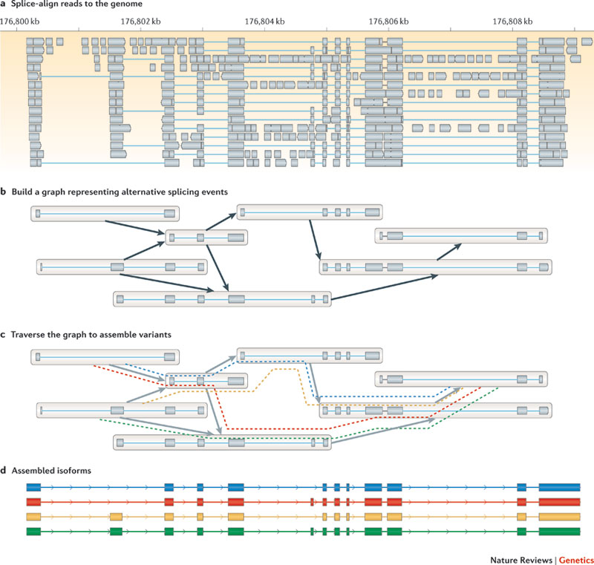
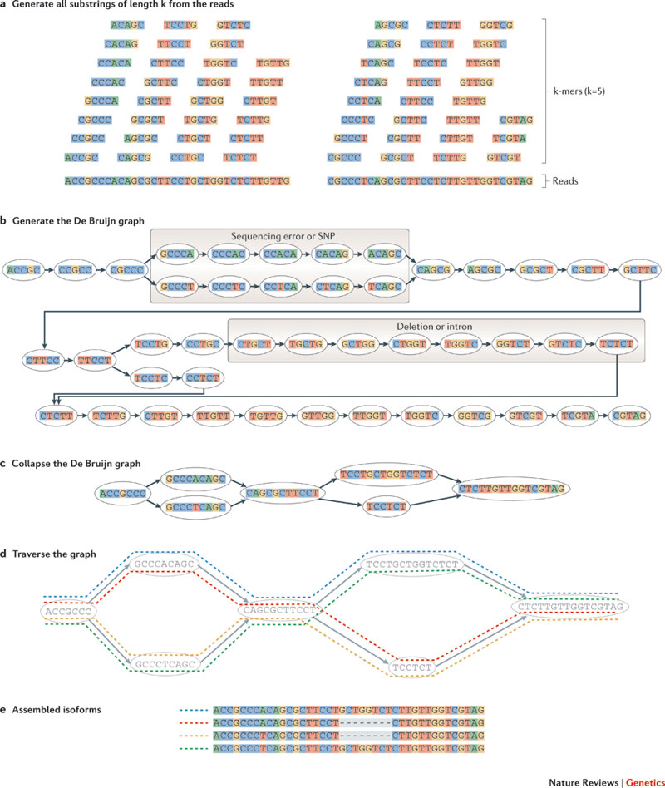
Construct transcriptome from short reads
Reference-based
De novo
Ref: Martin&Wang, Nature Review Genetics, 2011

Slide 30
RNA-seq procedure
Experiment
Bioinformatics
Align the raw reads to a genome with a RNA-seq aligner
Isolate RNA
Convert to cDNA using reverse transcriptase
Make a library and sequence it
Preprocess the reads for quality control
Quantify with normalization
Construct Transcriptome
Library preparation
Perform statistical tests for differential expression
Pathway & Network analysis
Misc.: (Mathematical modelling, gene ontology, combined analysis with other seq’s, …
Further analysis (Optional)
Clustering: Principal Component Analysis (PCA), Hierarchical clustering, etc.
Visualization: Heatmap, Volcano plot, Scatter plot, etc.

Slide 31
Quantification
Counting reads per gene
featureCounts, HTSeq, BEDTools, etc.
Counting reads per transcript
Cufflinks
Counting reads per exon
DEXSeq, etc.

Slide 32
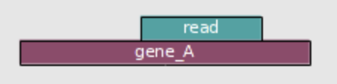
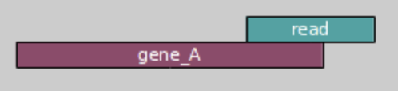
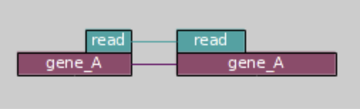
Quantification
Counting reads per gene
featureCounts, HTSeq, BEDTools, etc.
Counting reads per transcript
Cufflinks
Counting reads per exon
DEXSeq, etc.

Slide 33
(Hands-on) Quantify the gene expression transcriptome-wide in RNA-seq
Step 1: Upload Gene annotation (GTF file) directly from UCSC
Step 2: Run “featureCounts” to quantify the gene expression

Slide 34
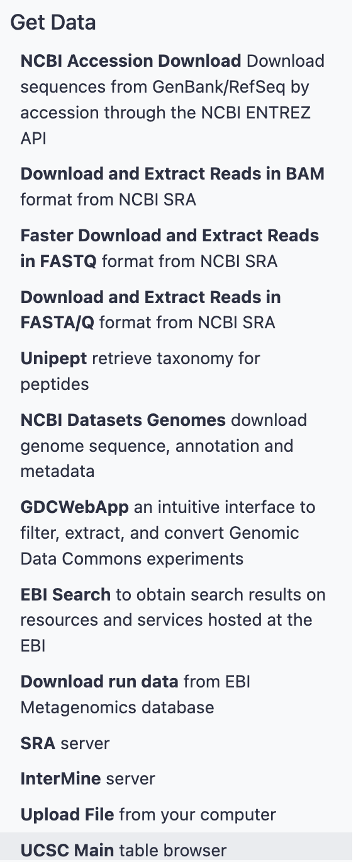
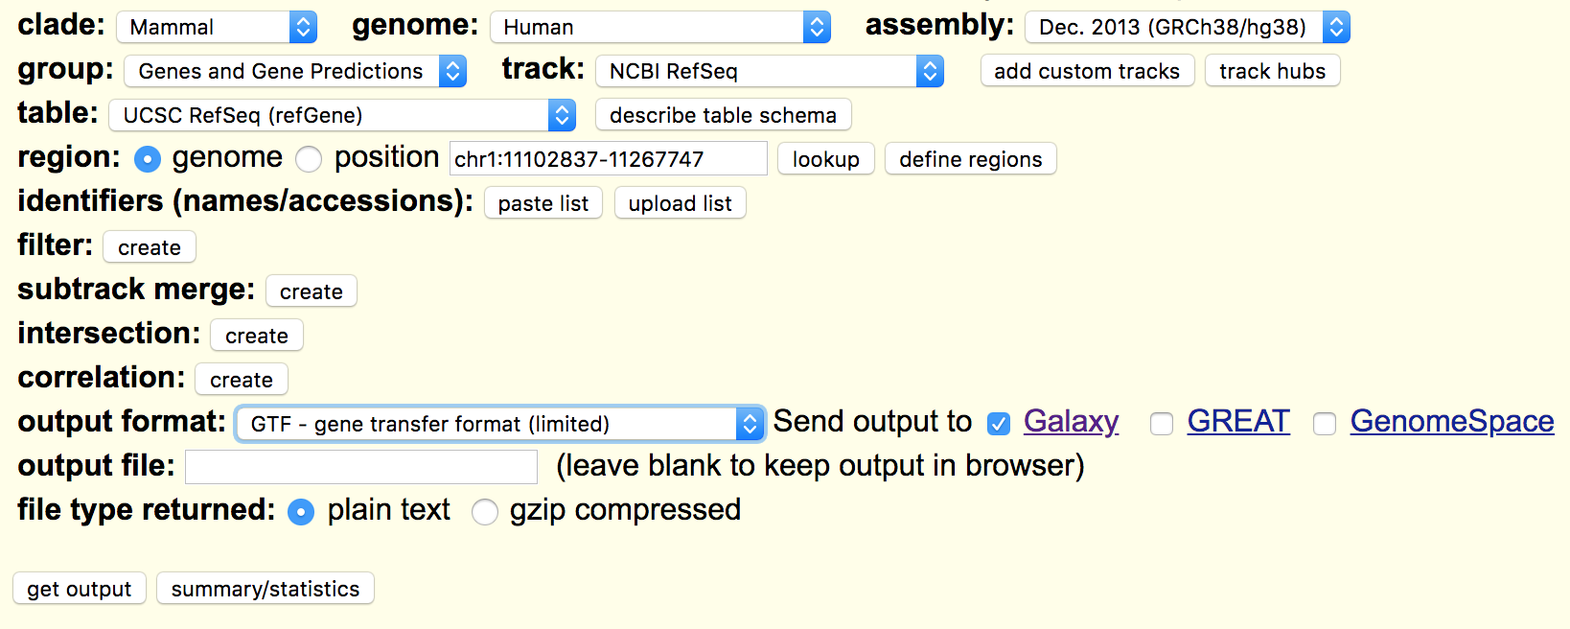
(Hands-on: Step 1) Uploading Gene Annotation File
Click “UCSC Main table browser” ➔ choose the parameters as above ➔ click “get output”

Slide 35
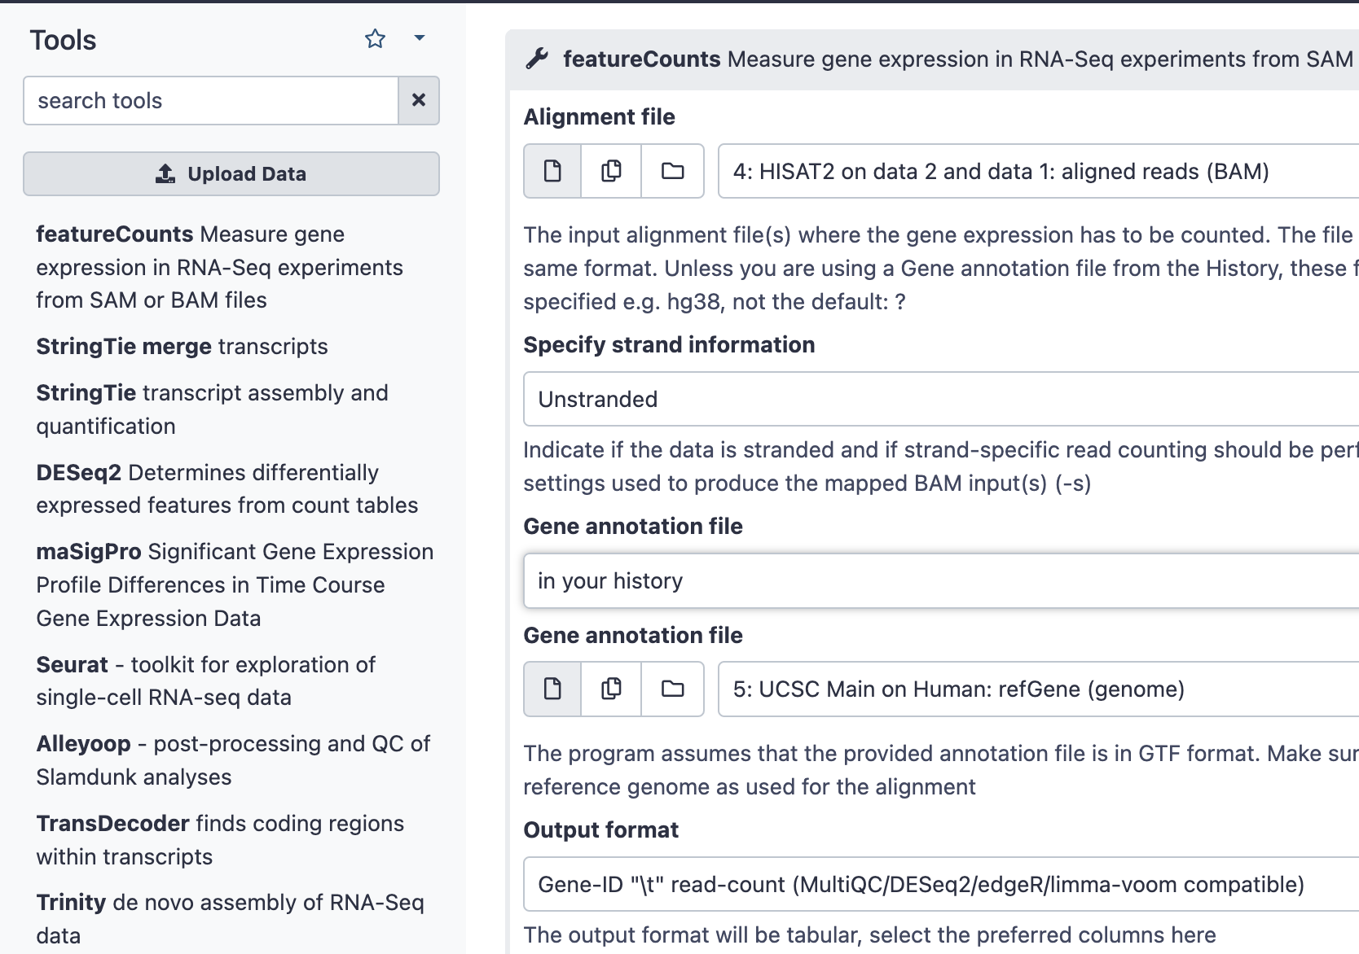
(Hands-on: Step 2) Quantify the gene expression transcriptome-wide in RNA-seq
Click “RNA-seq”
Click “featureCounts”
Choose parameters
Input bam
Gene annotation from history
Click “Execute”

Slide 36

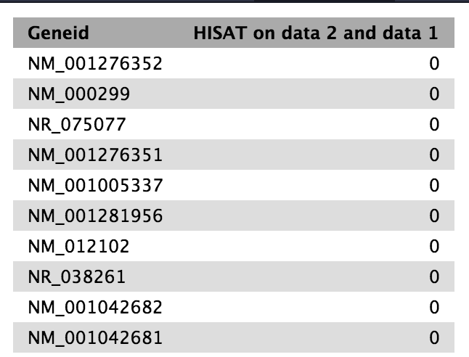
featureCounts give counts of reads per gene

Slide 37
(Hands-on) Counts reads per gene for three other samples
You counted for one replicate sample under experimental condition
Count for three other samples
Experiment_rep2
Control_rep1
Control_rep2

Slide 38
Quantifying gene expression in RNA-seq Raw counts vs. FPKM
Counts the number of reads aligned to a gene
vs.
Normalize the counts
A popular normalization method: RPKM or FPKM
RPKM: Reads Per Kilobase of exon per Million reads mapped (frequently used in single end reads)
FPKM: Fragments Per Kilobase of exon per Million fragments mapped (frequently used in paired end reads)

Slide 39
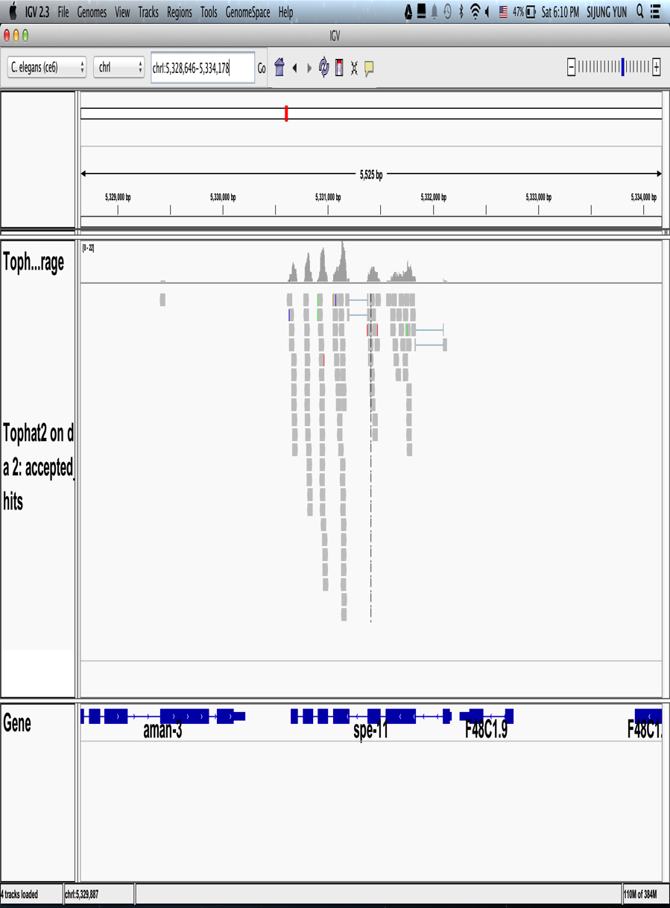
(Example) Raw count vs. FPKM
For this gene
(e.g.) Raw counts of reads mapped = 125
FPKM calculation
(e.g.) Total number of reads mapped = 25 million reads
(e.g.) This gene has 2 kb of bases for exons
FPKM = 125 / 2 / 25 = 2.5

Slide 40
(Discussion) does fpkm represent gene expression well?

Slide 41
RNA-seq procedure
Experiment
Bioinformatics
Align the raw reads to a genome with a RNA-seq aligner
Isolate RNA
Convert to cDNA using reverse transcriptase
Make a library and sequence it
Preprocess the reads for quality control
Quantify with normalization
Construct Transcriptome
Library preparation
Perform statistical tests for differential expression
Pathway & Network analysis
Misc.: (Mathematical modelling, gene ontology, combined analysis with other seq’s, …
Further analysis (Optional)
Clustering: Principal Component Analysis (PCA), Hierarchical clustering, etc.
Visualization: Heatmap, Volcano plot, Scatter plot, etc.

Slide 42
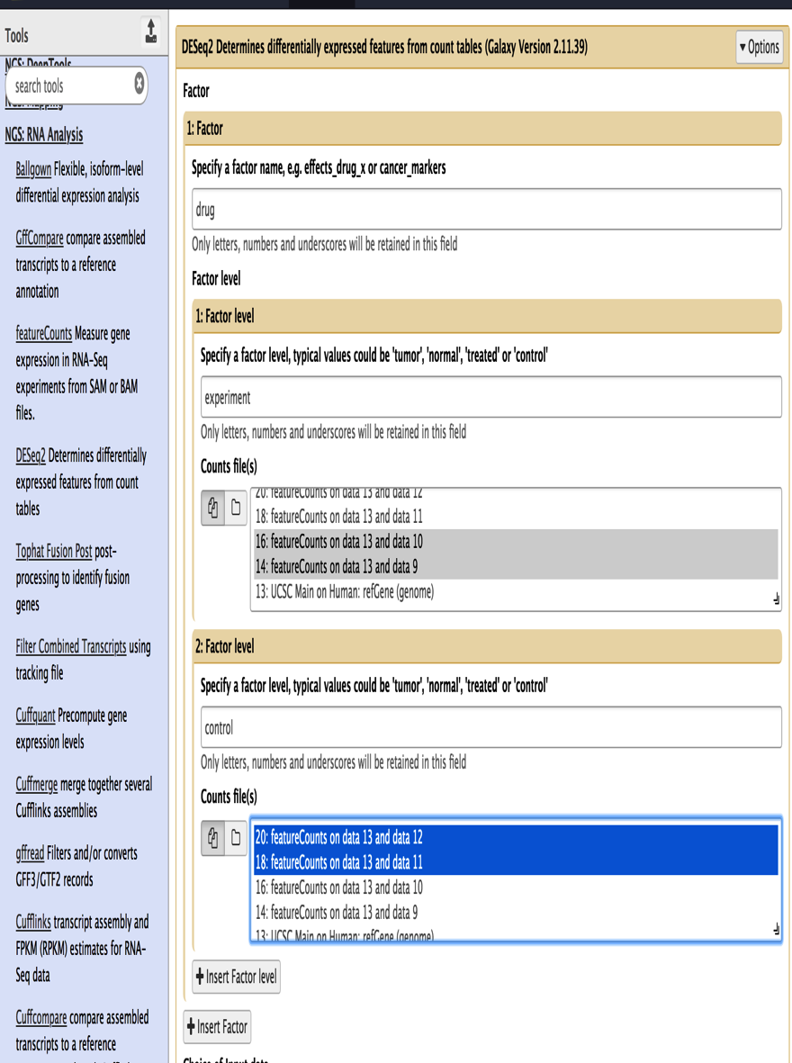
(Optional Hands-on) Differential gene expression analysis
NGS:RNA Analysis ➔ DESeq2 ➔Choose paramters ➔ Execute

Slide 43
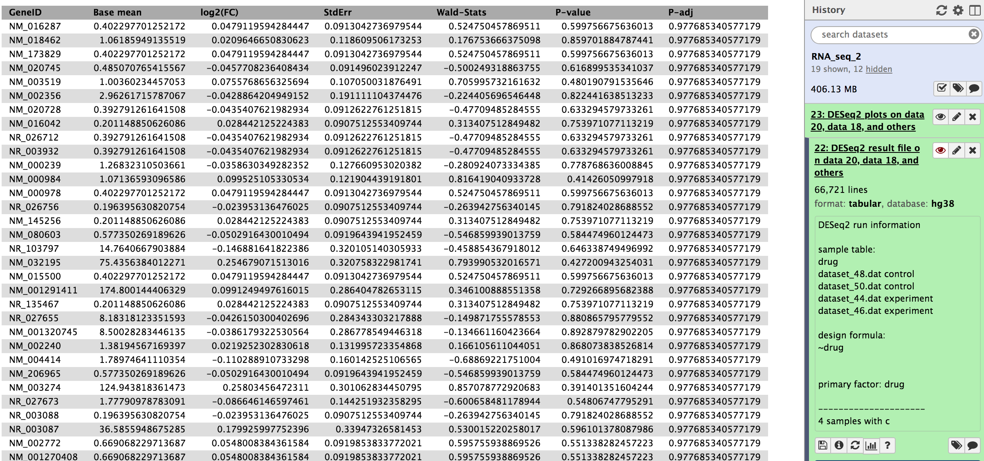

Slide 44
How to do the differential expression?
Topics to discuss further

Slide 45
Differential gene expression
(Q) Is this Gene A differentially expressed?
One RNA-seq for male and for female, for each
(Hypothetical example) Expression for Gene A
Male | Read counts | FPKM
1_male | 10 | 1.0
Female | Read counts | FPKM
1_female | 100 | 10

Slide 46
Differential gene expression
(Q) Is this Gene A differentially expressed?
Triplicates for male and for female, for each
(Hypothetical example) Expression for Gene A
Male | Read counts | FPKM
1_male | 8 | 0.9
2_male | 10 | 1.0
3_male | 12 | 1.1
Female | Read counts | FPKM
1_female | 80 | 9
2_female | 100 | 10
3_female | 120 | 11

Slide 47
Differential gene expression
(Q) Is this Gene A differentially expressed?
Triplicates for male and for female, for each
(Hypothetical example) Expression for Gene A
Two-sample T-test for p-value calculation?
Male | Read counts | FPKM
1_male | 8 | 0.9
2_male | 10 | 1.0
3_male | 12 | 1.1
Female | Read counts | FPKM
1_female | 80 | 9
2_female | 100 | 10
3_female | 120 | 11

Slide 48
Differential gene expression
(Q) Is this Gene A differentially expressed?
Triplicates for male and for female, for each
(Hypothetical example) Expression for Gene A
Negative binomial works better for RNA-seq
Male | Read counts | FPKM
1_male | 8 | 0.9
2_male | 10 | 1.0
3_male | 12 | 1.1
Female | Read counts | FPKM
1_female | 60 | 8
2_female | 100 | 10
3_female | 140 | 12
Variance grows faster than the mean

Slide 49
Differential expression analysis using DESEQ2
Goal
Identify genes differentially expressed with statistical significance for the conditions to compare against
e.g. Post vs. Before for GroupX
Algorithm
Estimate the sample dependent normalization constant called “size factor”
Estimate the gene-wise dispersion
Use negative binomial Generalized Linear Model and Wald statistics to calculate the significance per gene
Ref: https://bioconductor.org/packages/release/bioc/vignettes/DESeq2/inst/doc/DESeq2.html
Notes:
DESEQ2 identifies differentially expressed genes by using statistical comparison on gene count tables. For example, if we compare Post vs. Before for GroupX, we upload all the relevant samples’ gene count table into memory. Then, normalization is performed by estimating the size factor of each sample and gene-wise dispersion, then, it applies a statistical testing based on negative binomial generalized linear model. P-values are estimated using Wald statistics.

Slide 50
Multiple testing correction
Topics to discuss further

Slide 51
Multiple testing correction: Bonferroni vs. FDR
What is multiple testing correction?
When we test multiple times, the probability (p’) of calling 1 or more false positives by chance increases!
(ex) If p=0.05 ➔ p’=1-(1-p)^{N}
N=1 => p’=0.05; N=2 => p’ = 0.0975; N=10 => p’=0.64; N=100 => p’=0.994
So, we need to correct the p-value to account for this

Slide 52
Multiple sample correction: Bonferroni vs. FDR
Two popular methods for multiple testing correction
Bonferroni: Corrected p-value (p’) = p-value * number of genes (i.e. 1000) < 0.05; p’ = 0.00005
Benjamini and Hochberg False Discovery Rate (FDR): It controls the proportions of significant results (discovery) that are actually false positives.
First sort genes in descending order with P-values of the each gene
If my p-value cutoff – 0.05 and the total number of gene is 1000, then p(Gene A) = 0.1 ➔ 1000/1000*0.1= 0.1 (not significant ➔ not significant)
P(Gene B) = 0.06 ➔ adjust p-value = minimum of (1000/999*0.06 ➔ 0.06006 or the previous P(A)) (not significant ➔ not significant)
P(Gene C) = 0.04999 ➔ adjusted p-value (1000/998*0.04999 ➔ 0.05009018 or the previous P(B)) (significant ➔ not significant)

Slide 53
Multiple sample correction: Bonferroni vs. FDR
Summary
Bonferroni: Very stringent, greatly reduced chance of false positives, increased chance of false negatives
FDR(Benjamini-Hochberg): the rate of false positive is fixed, reduced risk for false negatives compared to Bonferroni

Slide 54
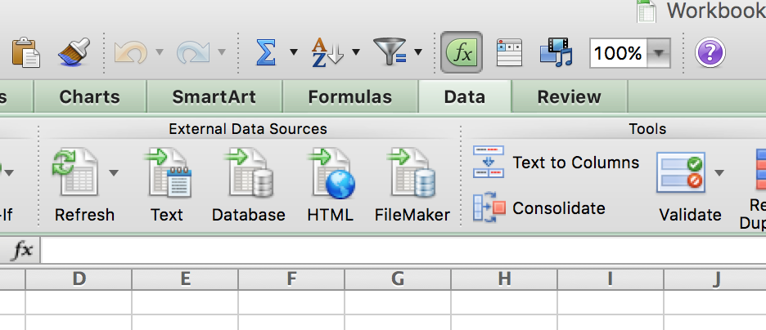
(Optional Hands-on) Getting differentially expressed genes in your MS Excel
2. Open MS Excel, and import the downloaded file: Data ➔ Text ➔ Choose the downloaded file

Slide 55
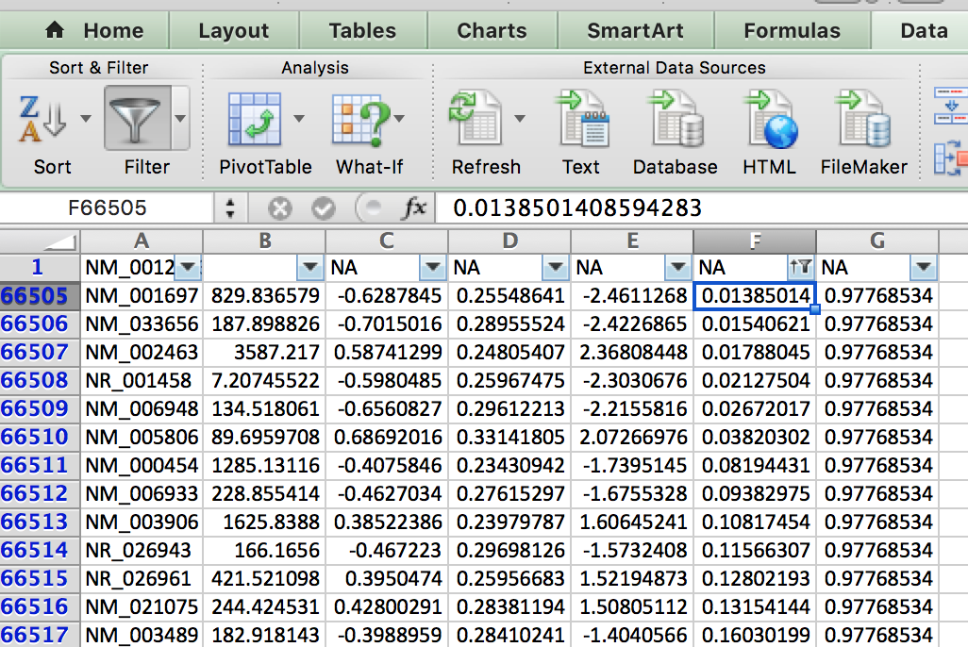
(Optional Hands-on) Getting differentially expressed genes in your MS Excel
2. You may do filter to remove ‘NA’ and sort by column F (p-value)

Slide 56
RNA-seq procedure
Experiment
Bioinformatics
Align the raw reads to a genome with a RNA-seq aligner
Isolate RNA
Convert to cDNA using reverse transcriptase
Make a library and sequence it
Preprocess the reads for quality control
Quantify with normalization
Construct Transcriptome
Library preparation
Perform statistical tests for differential expression
Pathway & Network analysis
Misc.: (Mathematical modelling, gene ontology, combined analysis with other seq’s, …
Further analysis (Optional)
Clustering: Principal Component Analysis (PCA), Hierarchical clustering, etc.
Visualization: Heatmap, Volcano plot, Scatter plot, etc.

Slide 57
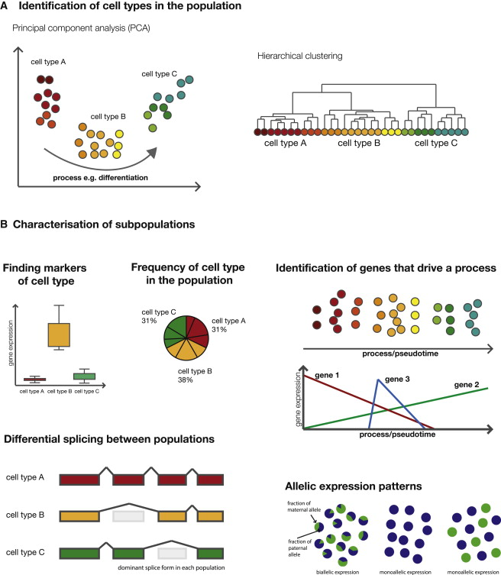
Clustering
Principal Component Analysis
(PCA)
Hierarchical clustering
Ref:Kolodziejczky et al.,
Mol. Cell Review, 2015

Slide 58
RNA-seq procedure
Experiment
Bioinformatics
Align the raw reads to a genome with a RNA-seq aligner
Isolate RNA
Convert to cDNA using reverse transcriptase
Make a library and sequence it
Preprocess the reads for quality control
Quantify with normalization
Construct Transcriptome
Library preparation
Perform statistical tests for differential expression
Pathway & Network analysis
Misc.: (Mathematical modelling, gene ontology, combined analysis with other seq’s, …
Further analysis (Optional)
Clustering: Principal Component Analysis (PCA), Hierarchical clustering, etc.
Visualization: Heatmap, Volcano plot, Scatter plot, etc.

Slide 59
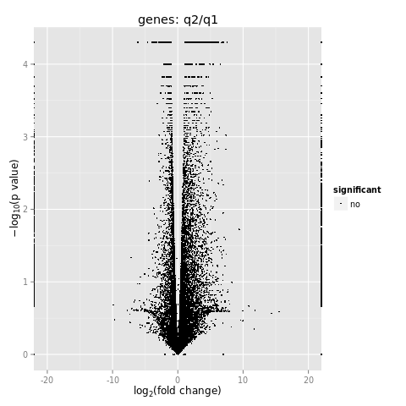
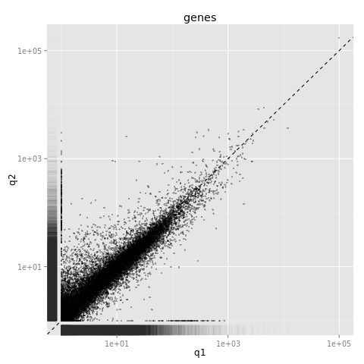
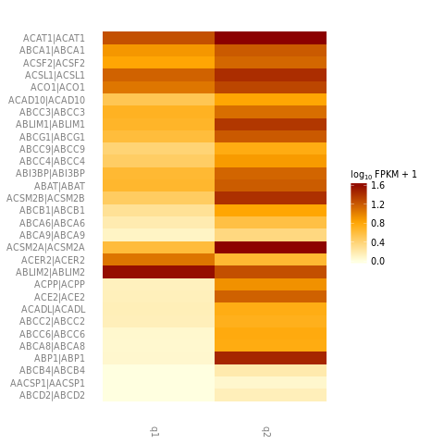
Popular plots in RNA-seq analysis
Volcano plot
Scattered plot
Heatmap plot

Slide 60
RNA-seq procedure
Experiment
Bioinformatics
Align the raw reads to a genome with a RNA-seq aligner
Isolate RNA
Convert to cDNA using reverse transcriptase
Make a library and sequence it
Preprocess the reads for quality control
Quantify with normalization
Construct Transcriptome
Library preparation
Perform statistical tests for differential expression
Pathway & Network analysis
Misc.: (Mathematical modelling, gene ontology, combined analysis with other seq’s, …
Further analysis (Optional)
Clustering: Principal Component Analysis (PCA), Hierarchical clustering, etc.
Visualization: Heatmap, Volcano plot, Scatter plot, etc.

Slide 61
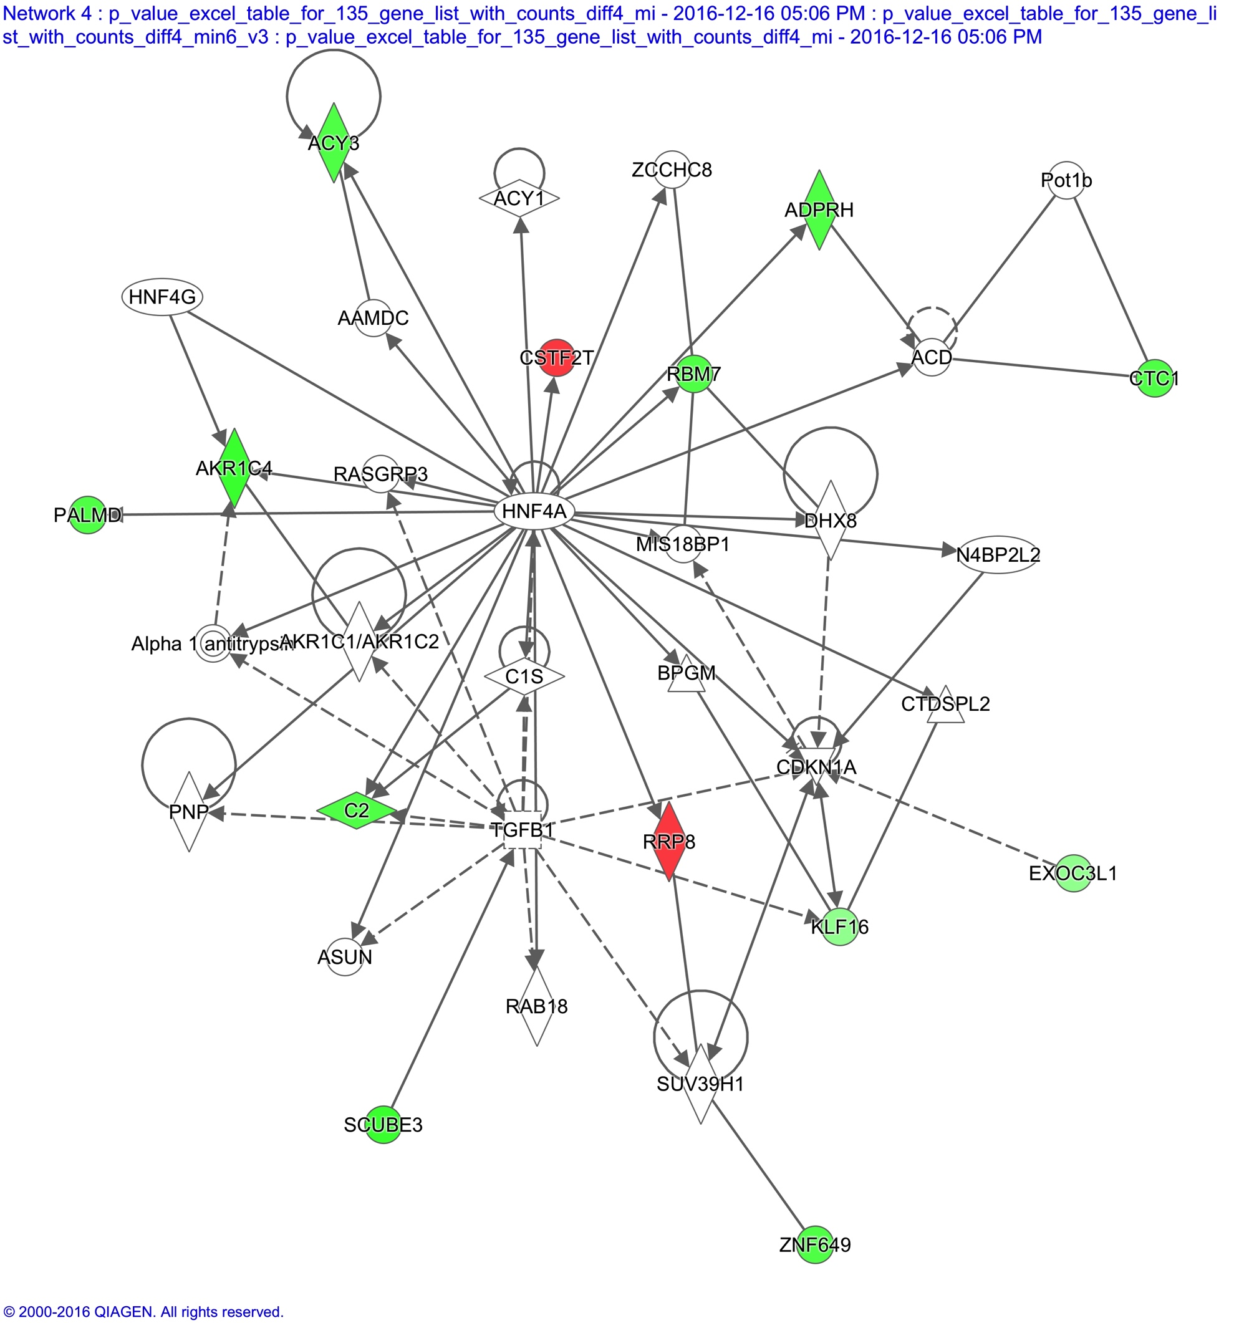
(Example) Pathway analysis
Legends
Red: Up-regulation
Green: Down-regulation
Diamond shape: Enzyme
Circle: Other molecules
Solid line: Direct interaction
Dotted line: Indirect interaction
Ingenuity IPA

Slide 62
RNA-seq can do these, too
Alternative expression
Novel transcript discovery
Allele specific expression (SNPs or mutations)
Fusion detection
RNA editing
miRNA
Long noncoding RNA
…

Slide 63
RNA-seq vs. micro-array
Topics to discuss further

Slide 64
RNA-seq vs. micro-array
RNA-seq
Micro-array
Measure the number of cDNA directly
Greater dynamic range
Cost effective
Novel transcripts could be found
Becoming more popular
Measure the intensity of hybridization with cDNA
Analysis methods well established including normalization

Slide 65
Supplementary slides

Slide 66
(Optional) Confusing words
Alignment vs. mapping
Tag vs. fragment vs. insert (size) vs. inner distance between mate pairs
Bandwidth
Single end read vs. paired end read vs. mate pair (see the next slide)
Do you have more?

Slide 67
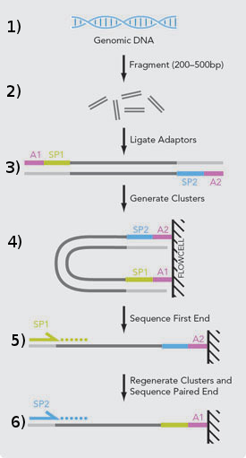
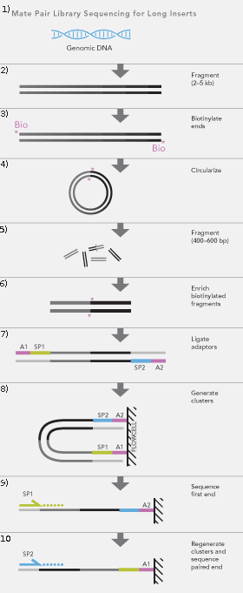
(Optional) Paired-end vs. mate-pair
Why paired-end
Simple
Why mate-pair
Longer inner dist.
Structural variants…
Ref:
http://rodrigoguarischi.com/mate-pair-
and-paired-end-sequencing-illumina/
Paired-end
Mate-pair

